Slide 1

Financial Transactions System
Submitted by : Shubh Goyal

Slide 2
Database
Centralized Financial Infrastructure:
The database serves as a centralized hub, orchestrating and managing diverse monetary interactions within the system.
Structured Data Management:
Designed for accuracy and reliability, the system excels in recording and organizing financial transactions through two key tables.
User-Centric Information Repository:
The 'Users Table' acts as a comprehensive repository, capturing essential user details and forming the foundation for user-centric financial insights.
Comprehensive Transactional Ledger:
The 'Transactions Table' functions as a detailed ledger, documenting each transaction's date, category, amount, and status for a systematic understanding of financial events.

Slide 3
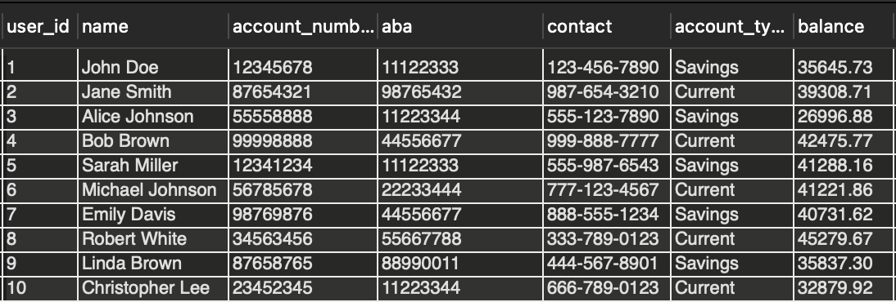
Users Table
Unique User Identification:
Each user is uniquely identified by a user_id, serving as a key reference point for all financial activities within the system.
Comprehensive User Details:
Essential user details include names, account_number, aba, and contact, providing a holistic view of individuals engaging with the financial transactions database.
Dynamic Financial Position:
The balance field reflects the real-time financial standing of users, updating dynamically with each financial transaction, whether it's a salary credit or a debit transaction.

Slide 4
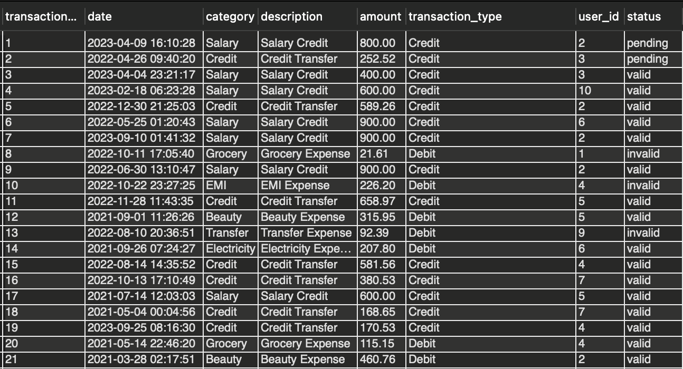
Transactions Table:
Traceable Transactions:
The transaction_id acts as a unique identifier, ensuring each financial interaction recorded in the 'Transactions Table' is distinguishable and traceable.
Nature and Status of Transactions:
The category field delineates the nature of transactions, ranging from groceries to salary credits, while the status field denotes the current state, be it pending, valid, or invalid.
Use of Python Script

Slide 5
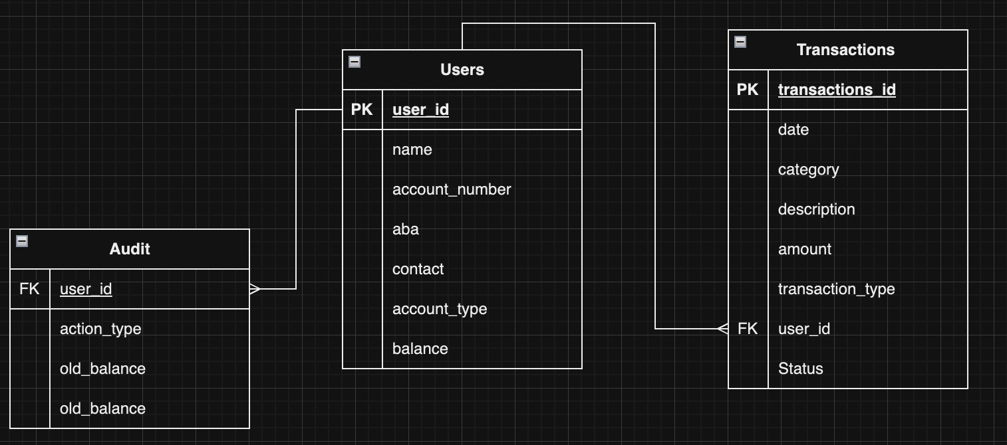
Database Design

Slide 6
Transaction Processing Logic
In the financial transactions database, triggers are implemented to ensure data integrity, specifically for 'debit' and 'credit' transactions. These triggers play a vital role in maintaining the consistency and reliability of financial records
1. Credit Transaction Trigger
2. Debit Transaction Trigger
These triggers collectively contribute to maintaining the consistency, accuracy, and reliability of financial data, upholding the principles of data integrity within the financial transactions database.

Slide 7
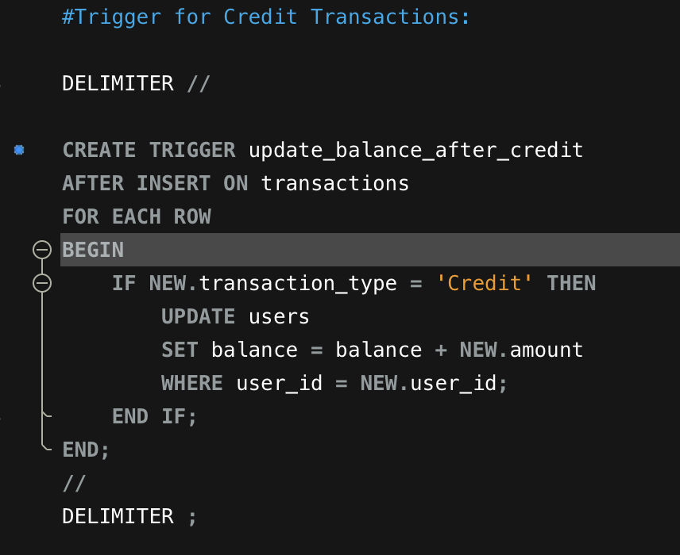
Credit Transaction Trigger:
Objective: The trigger is implemented to handle 'credit' transactions and maintain an accurate representation of user balances.
Implementation: After the insertion of a new record into the 'Transactions Table' for a 'credit' transaction, the trigger updates the user's balance in the 'Users Table.'
Balance Adjustment: The trigger increases the user's balance by the credited amount, reflecting the positive impact of the credit transaction on the user's financial standing.
Impact on Data Integrity: By automatically adjusting user balances upon the completion of a 'credit' transaction, this trigger ensures that the financial records accurately represent the impact of transactions on individual user accounts, contributing to data integrity.

Slide 8
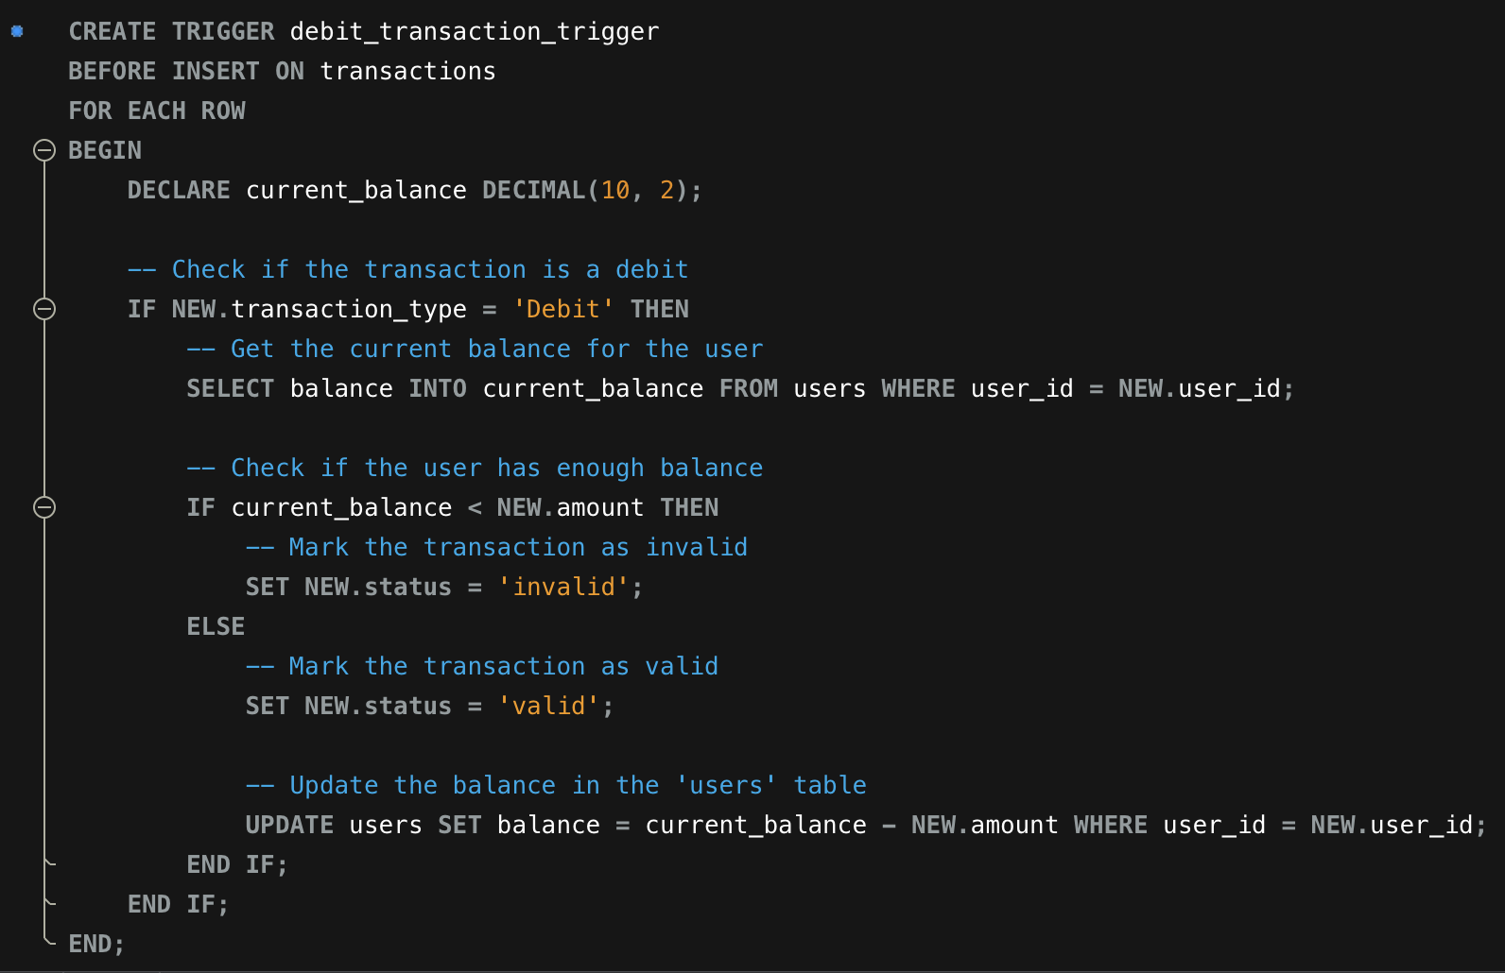
Debit Transaction Trigger
Objective: The trigger is designed to validate and process 'debit' transactions, ensuring that users have sufficient balance before completing a debit transaction.
Implementation: Before the insertion of a new record into the 'Transactions Table' for a 'debit' transaction, the trigger checks the user's current balance in the 'Users Table.’
Validation: If the user's balance is insufficient for the debit amount, the trigger marks the transaction as 'invalid,' preventing the database from accepting the transaction. Otherwise, it marks the transaction as 'valid' and updates the user's balance accordingly.
Impact on Data Integrity: This trigger ensures that 'debit' transactions are processed accurately and that users cannot engage in transactions that would lead to a negative balance, maintaining the integrity of financial data.

Slide 9
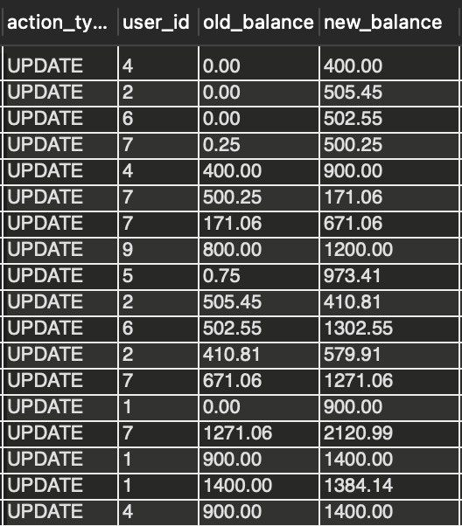
Audit Table
Purpose: The 'audit' table serves as a historical record, capturing every modification or action performed on the database. It acts like a time machine, storing the state of data before and after changes.
Significance: This feature enhances transparency, accountability, and security. It allows users to trace back and understand the evolution of financial data, making it invaluable for compliance, forensic analysis, and identifying irregularities.

Slide 10
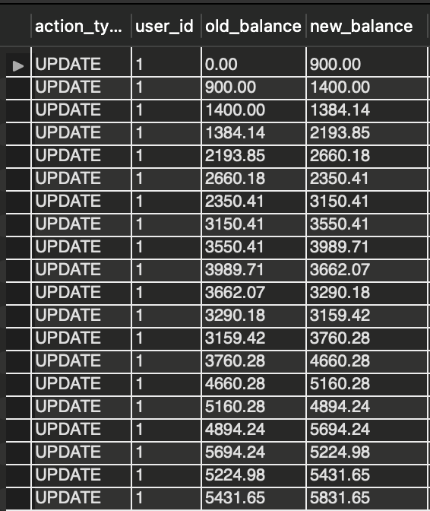
The stored procedure to fetch the audit trail for a given user.
Purpose: The 'GetAuditTrail' feature is a tool to retrieve detailed information from the 'audit' table, providing a structured way to access historical data.
Significance: Users can utilize this feature to investigate specific transactions, understand who made changes, and discern the chronological sequence of events. It empowers users with the ability to reconstruct past states of the database, ensuring a comprehensive view of transactional history.

Slide 11
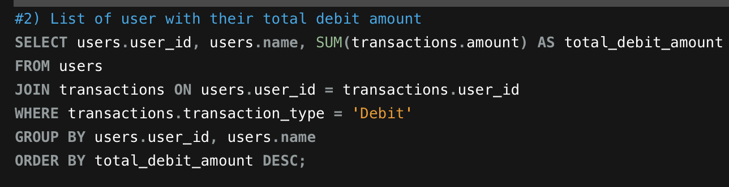
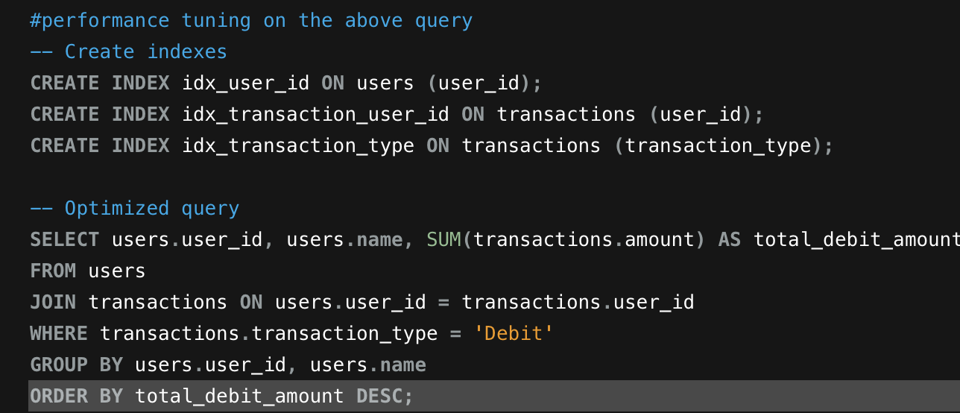
Performance tuning on : List of user with their total debit amount
Query Analysis
Proposed Tuning Suggestions
Index Optimization
Executed the tuned query after implementing suggestions :

Slide 12

Data visualization using Tableu

Slide 13
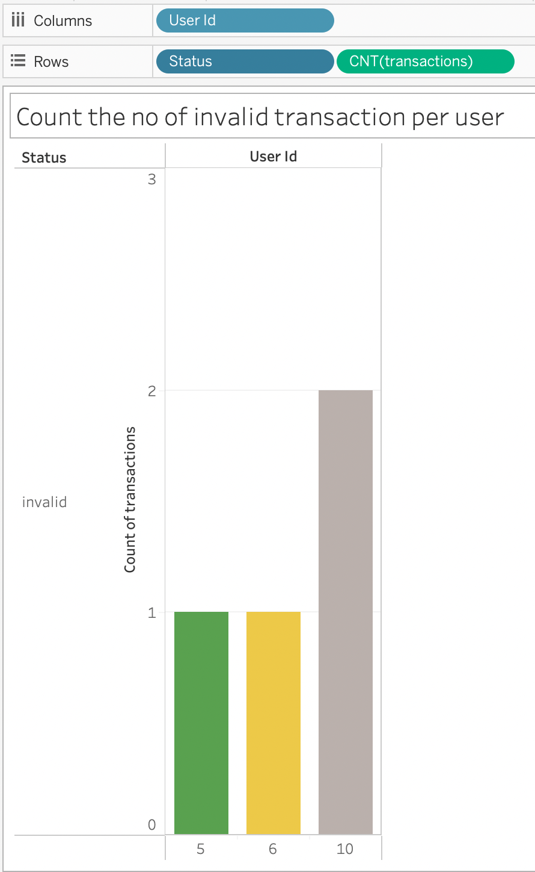
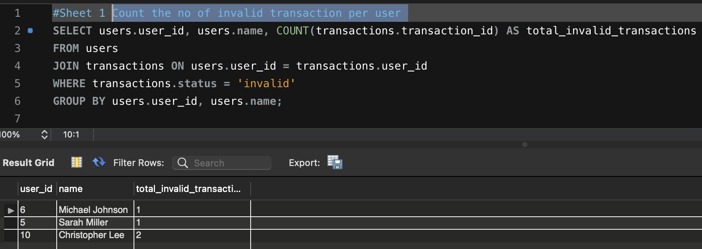
1) Count the no of invalid transaction per user

Slide 14
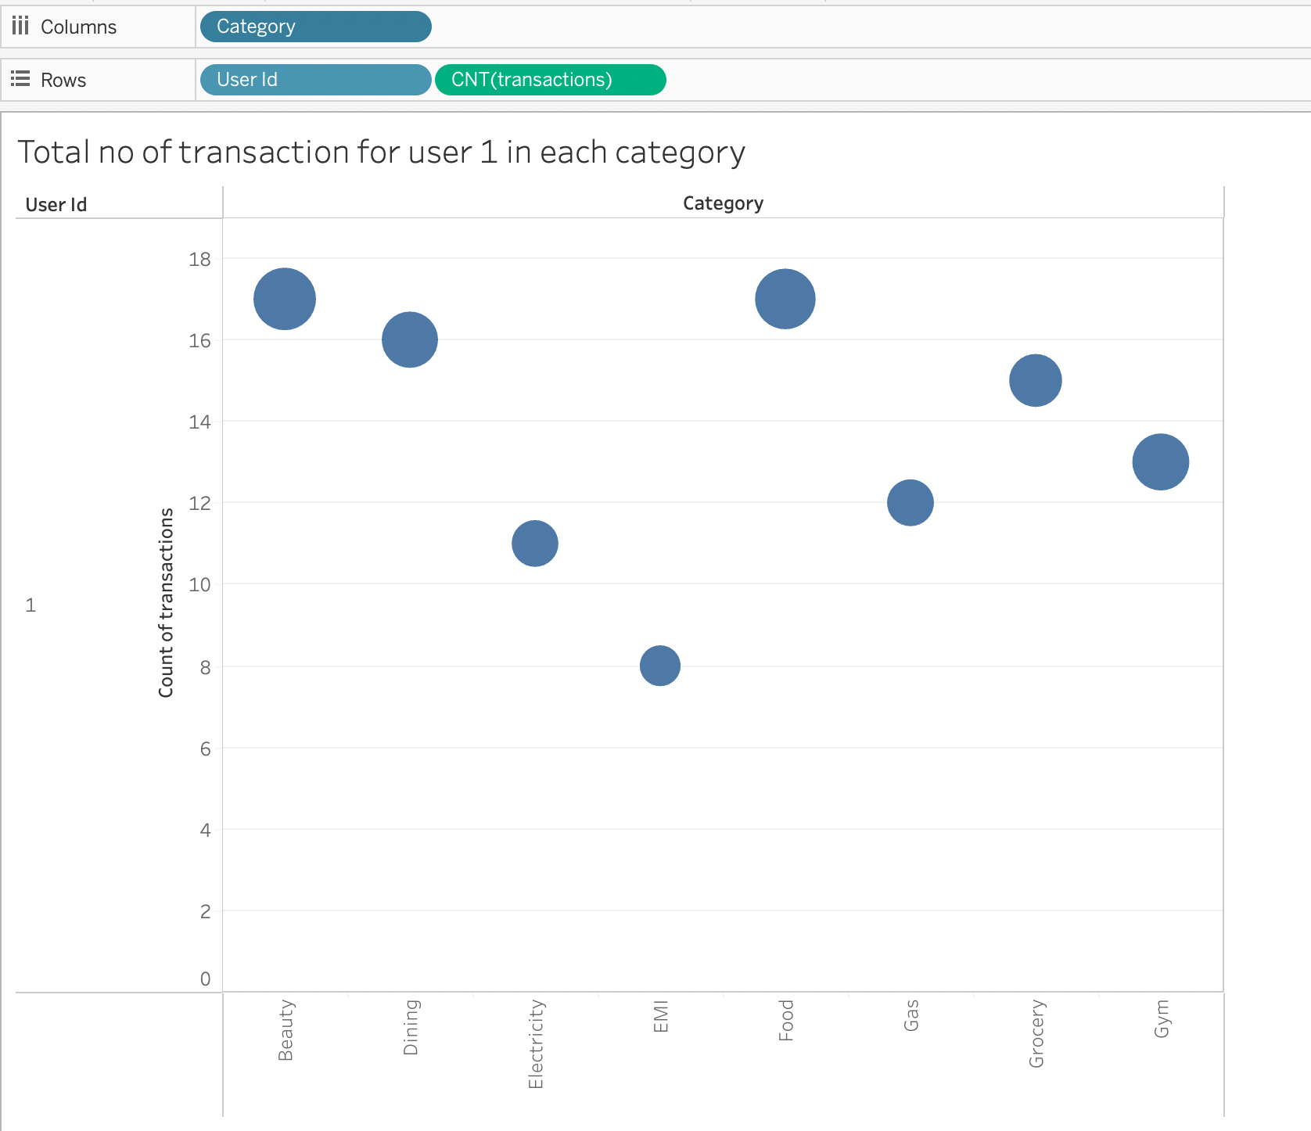
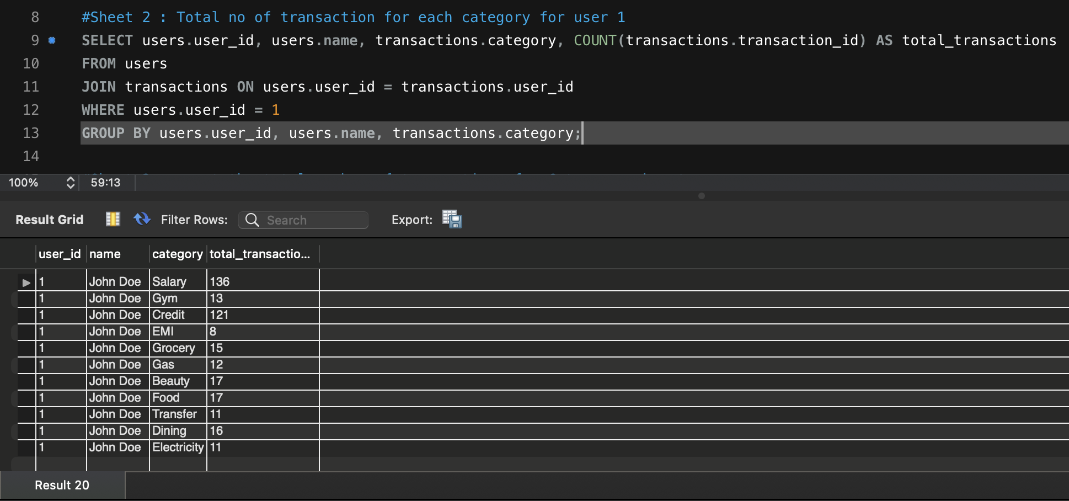
2) Total no of transaction for user 1 in each category

Slide 15

Thank You

